Slide 1


Slide 2

URBAN FARMING

Slide 3
URBAN FARMING
It creates less food waste as food from urban farm reaches the consumer faster and therefore lasts longer after having been purchased.
Urban Farming is also usually Organic which means the produce is more nutritious compared to products grown in large-scale farms which use pesticides…
Plants absorb carbon which helps fight climate change whereas green spaces have been proven to also reduce air pollution…
Garden plots can be up to 15 times more than productive than rural holdings. An area of just one square meter can provide 20kgs of food each year…

Slide 4
TYPES OF URBAN FARMING
Arable: Crops
Pastoral: Animals
Mixed: Crops and animals
Subsistence: Grown just for the farmer and his family
Commercial: Grown to sell
Intensive: High inputs of labour or capital usually small
Extensive: Low inputs of labour or capital
Sedentary: Permanently in in one place
Nomadic: The farmers move around to find new areas to farm

Slide 5
PROBLEM STATEMENT
WHAT IS A PROBLEM..?
Lack of drinking water facilities.., water disposal.., shortage of civic amenities and sanitation
WHY THE PROBLEM..?
There is no proper facilities which are required for farming…
HOW WE HAVE TO SLOVE THE PROBLEM..?
We enable market access to quality seeds, crop-specific fertilizers and agricultural lime…
TO WHOM THE PROBLEM..?
In recent years there has occurred a fall in agricultural production mainly due to fall in the output of non-food articles…

Slide 6
Persona
A farmer is a person engaged in agriculture, raising living organisms for food or raw materials.. The term usually applies to people who do some combination of raising field crops, orchards, vineyards, poultry, or other livestock…

Slide 7
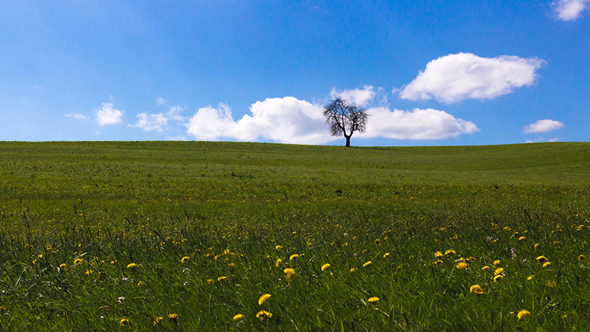
URBAN FARMING
There is a survey on Urban Farming
Date : 10th February, 2022
Venue : K L University

Slide 8
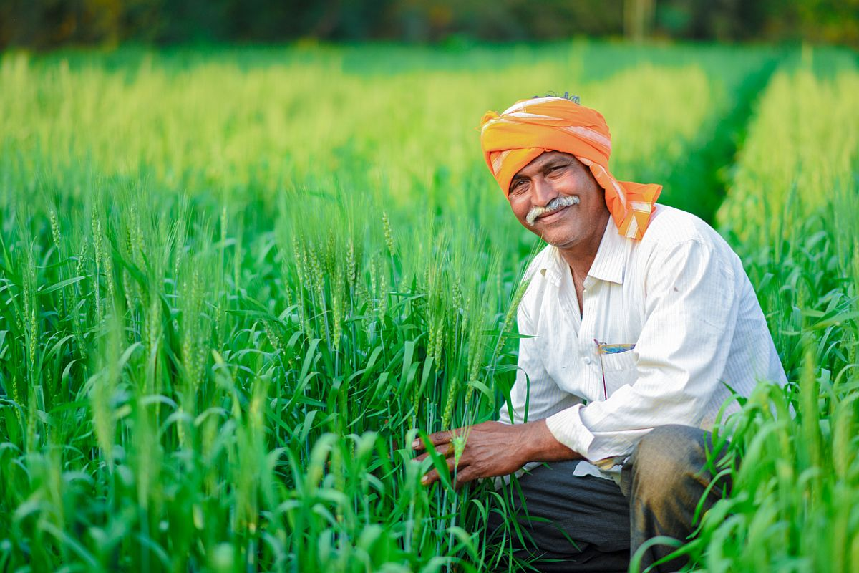
Survey for Urban Farming
What is Urban Farming..?
Urban farming is a system, which avoids or largely excludes the use of synthetic inputs and to the maximum extent feasible relies upon crop rotations, crop residues, animal manures, off-farm organic waste, mineral grade rock additives and biological system of nutrient mobilization and plant protection.
What are the benefits of Urban Farming..?
It helps in keeping agricultural production at a higher level and makes it sustainable.
It reduces the cost of agricultural production and also improves the soil health.
It not only saves energy for both animal and machine, but also reduces risk of crop failure.
It helps in maintaining environment health by reducing the level of pollution
Can you describe any environmentally friendly practices which you have used to replace
chemical pesticides?
Demonstrates knowledge of environmentally friendly farming practices.
How do you ensure the proper functioning of farm equipment?
Demonstrates knowledge of ensuring farm equipment is used correctly.
What method do you use to demonstrate and describe techniques, practices, and safety regulations to
laborers? Provide an example.
Demonstrates leadership skills and ability to demonstrate and describe farming knowledge effectively.
How is your ability to work under pressure?
Demonstrates time management skills and ability to prioritize.

Slide 9
How to solve the problems in Urban Forming..?
Seeds:
The emerging global challenges like climate change, pest resistance, herbicide tolerance, higher costs to R&D, and supply chain disruptions have made the seed industry facing challenging future…
Cropping Pattern:
There has occurred a fall in agricultural production
mainly due to fall in the output of non-food articles.
The systems and techniques of farming,
The marketing of agricultural products
The indebtedness of the farmers.

Slide 10
Point of View About Urban Forming
Growth in agriculture remains more poverty reducing than growth
The poorest benefit most from agricultural growth
The comparative advantage of agriculture is not limited to landlocked countries
Agriculture is the main occupation. It provides employment to nearly 61% persons of total population.

Slide 11
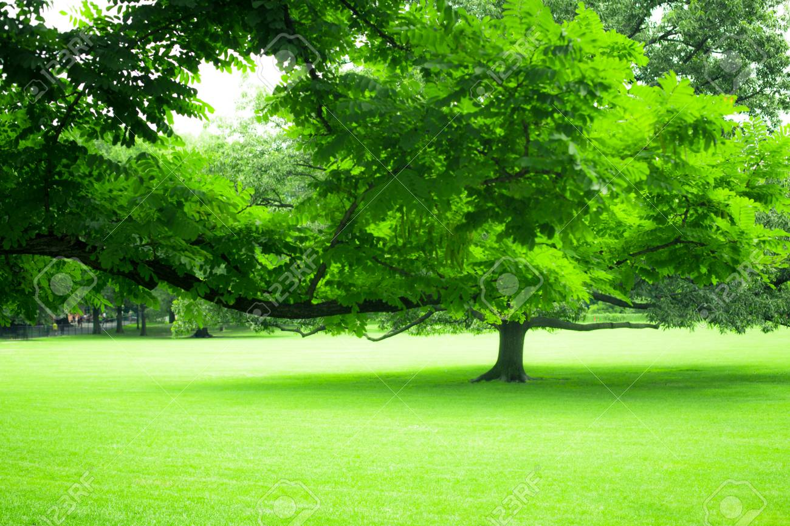
THANK YOU

